Slide 1
kHz Pulsed Beam Micro-Positioning
BELLA HTU

Slide 2
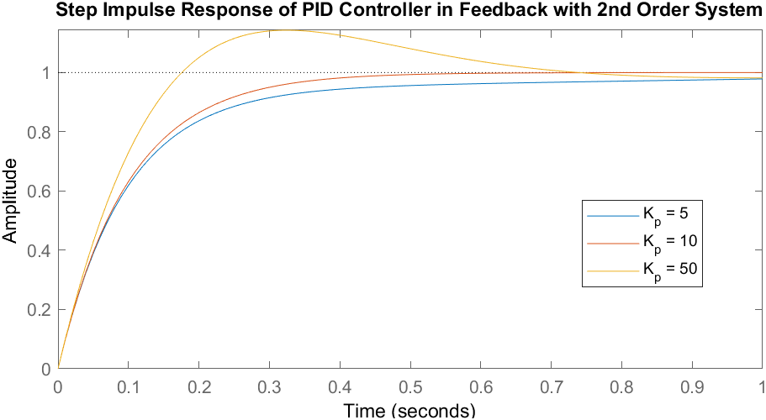
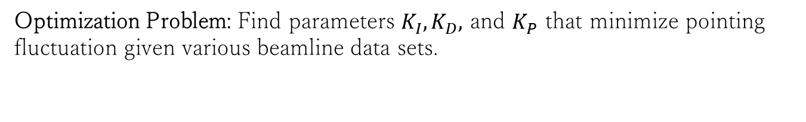
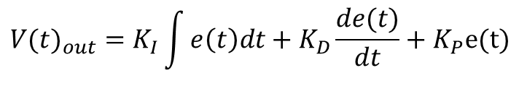
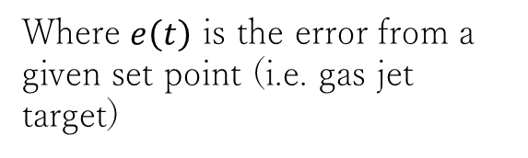
A Traditional Method
Where $e\left(t\right)$ is the error from a given set point (i.e. gas jet target)
$${{V(t)}_{out}=K}_{I}\int{e\left(t\right)dt}+K_{D}\frac{de(t)}{dt}+K_{P}e(t)$$
PID Feedback Algorithm:
Optimization Problem: Find parameters $K_{I},K_{D},$ and $K_{P}$ that minimize pointing fluctuation given various beamline data sets.

Slide 3
A Traditional Method
PID optimized on dataset using MATLAB.

Slide 4
kHz vs. CW:
A kHz pulse beam effectively lowers the bandwidth of a control system.
A PID controller loses performance when it can’t output corrections at a high rate (below 10–100 kHz).
A PID controller is naïve. For disturbance rejection, its effective ‘prediction’ is limited by 3 constant parameters.
In particular, the ‘derivative’ term is poor at noise rejection.
Chess vs. Boxing: There’s 1 ms of dead-time in the control loop that could be used to model the noise and
make a prediction as to its next “move”, in addition to reacting to residual errors.

Slide 5
kHz vs. CW:
Why not leverage the fluctuations spectral content in real-time control?

Slide 6
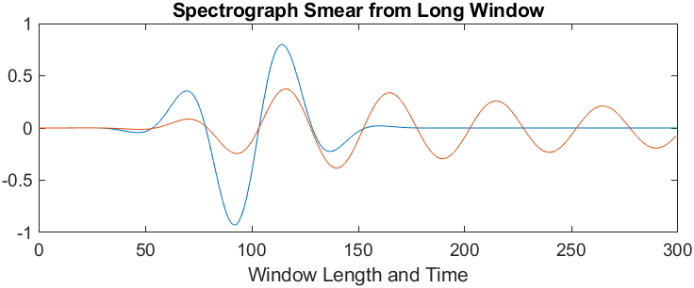
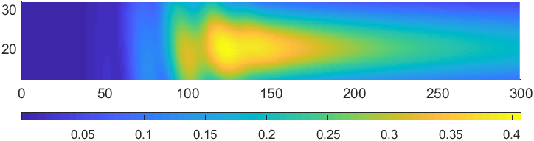
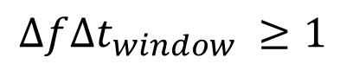
Transiency: Resolving Fast Changes in Amplitude
$$∆f∆t_{window} ≥1$$

Slide 7
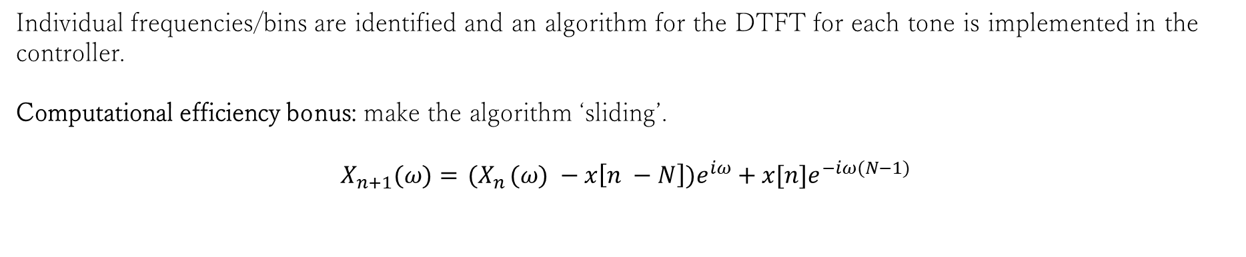
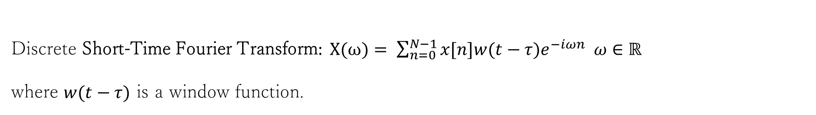
Transiency:
Discrete Short-Time Fourier Transform$: X(ω)= \sum_{n=0}^{N−1}{x[n]{w(t−τ)e}^{−iωn} ω∈ℝ}$
where $w(t−τ)$ is a window function.
forecasting window
new sample
Individual frequencies/bins are identified and an algorithm for the DTFT for each tone is implemented in the controller.
Computational efficiency bonus: make the algorithm ‘sliding’.
$$X_{n+1}(ω)={ (X}_{n}(ω) −x\left[n −N\right])e^{iω}+x[n]e^{−iω(N−1)}$$

Slide 8
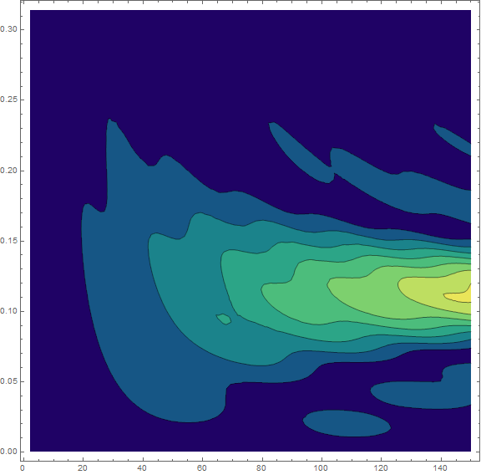
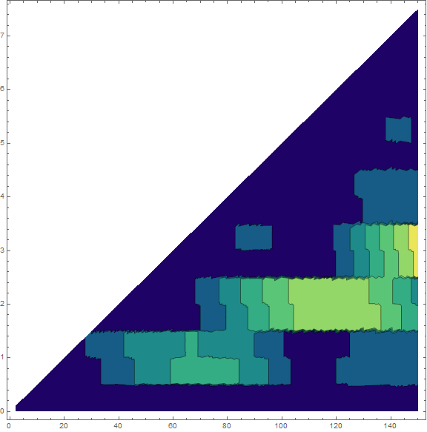
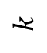
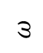
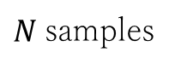
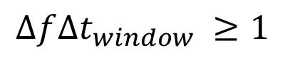
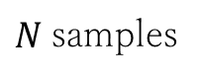
Continuous Transform on Discrete Data vs. Integer-valued (FFT,DFT)
$$ω$$
$$k$$
$N$samples
$N$samples
In both plots, an inherent rectangular window function adds lobes and width to the frequency response inversely proportional to the window length N.
However, too long of a window and the ability of the system to quickly react to frequency changes is lost.
$$∆f∆t_{window} ≥1$$

Slide 9
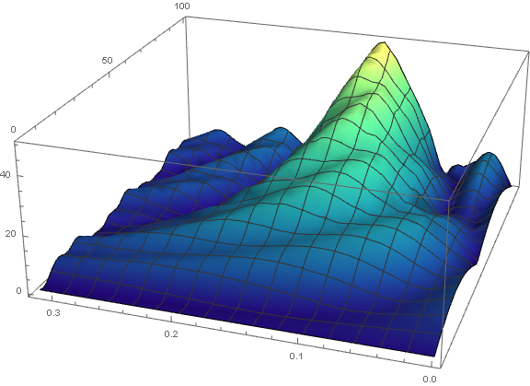

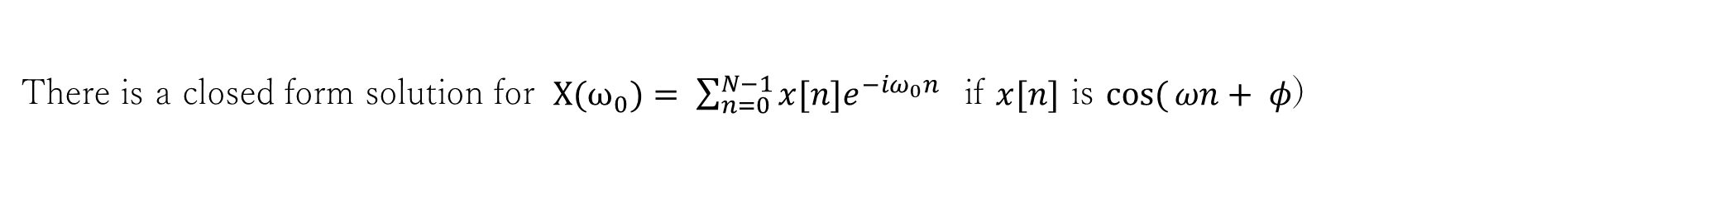
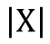
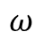
Lobes: Important for Low N
There is a closed form solution for $X(ω_{0})= \sum_{n=0}^{N−1}{x[n]e^{−iω_{0}n}}$ if $x[n]$ is $cos({ωn+ φ}$)
$N$Samples
$$\left|X\right|$$
$$ω$$
Notes:
$${\left|X\left(k,k_{0},N\right)\right|}^{2}=\frac{\sin^{2}({π(k−k_{0})}) }{\sin^{2}({{π(k−k_{0})}/N })}+\frac{\sin^{2}({π(k+k_{0})}) }{\sin^{2}({{π(k+k_{0})}/N })}+2\cos{(}{2π(k+k_{0}}/N))$$

Slide 10

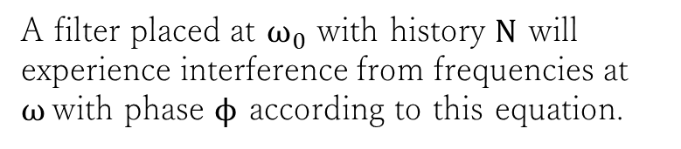
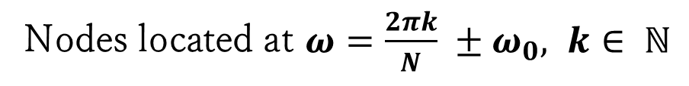
Lobes: Important for Low N
Frequency Response $X(ω_{0},ω,N, ϕ)= e^{−{iω\left(N−1\right)}/2−ϕ}\frac{\sin{\frac{\left(ω+ω_{0}\right)N}{2} }}{\sin{\frac{\left(ω+ω_{0}\right)}{2} }}+$ $e^{{iω\left(N−1\right)}/2+ϕ}\frac{\sin{\frac{\left(ω−ω_{0}\right)N}{2} }}{\sin{\frac{\left(ω−ω_{0}\right)}{2} }}$
A filter placed at $ω_{0}$ with history $N$ will experience interference from frequencies at $ω$with phase $ϕ$ according to this equation.
$N$Samples
Lobe interference is minimized either through good choice of sampling length $N$, filter placement $ω_{0}$, or window function.
$$\left|X\right|$$
Nodes located at $ω=\frac{2πk}{N} ±ω_{0}, k∈ ℕ$
Provides orthogonality
$$ω$$
Notes:
$${\left|X\left(k,k_{0},N\right)\right|}^{2}=\frac{\sin^{2}({π(k−k_{0})}) }{\sin^{2}({{π(k−k_{0})}/N })}+\frac{\sin^{2}({π(k+k_{0})}) }{\sin^{2}({{π(k+k_{0})}/N })}+2\cos{(}{2π(k+k_{0}}/N))$$

Slide 11
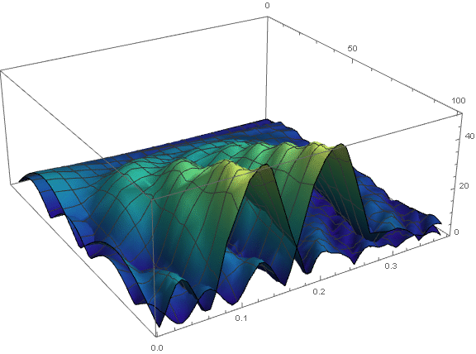
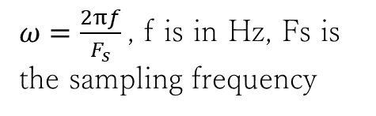
Lobes: Important for Low N
Frequency Response $X(ω_{0},ω,N, ϕ)= e^{−{iω\left(N−1\right)}/2−ϕ}\frac{\sin{\frac{\left(ω+ω_{0}\right)N}{2} }}{\sin{\frac{\left(ω+ω_{0}\right)}{2} }}+$ $e^{{iω\left(N−1\right)}/2+ϕ}\frac{\sin{\frac{\left(ω−ω_{0}\right)N}{2} }}{\sin{\frac{\left(ω−ω_{0}\right)}{2} }}$
A filter placed at $ω_{0}$ with history $N$ will experience interference from frequencies at $ω$with phase $ϕ$ according to this equation.
Lobe interference is minimized either through good choice of sampling length $N$, filter placement $ω_{0}$, or window function.
Nodes located at $ω=\frac{2πk}{N} ±ω_{0}, k∈ ℕ$
Provides orthogonality
$ω=\frac{2πf}{F_{s}}$, f is in Hz, Fs is the sampling frequency
Notes:
$${\left|X\left(k,k_{0},N\right)\right|}^{2}=\frac{\sin^{2}({π(k−k_{0})}) }{\sin^{2}({{π(k−k_{0})}/N })}+\frac{\sin^{2}({π(k+k_{0})}) }{\sin^{2}({{π(k+k_{0})}/N })}+2\cos{(}{2π(k+k_{0}}/N))$$

Slide 12
Optimized Filters HTU

Slide 13
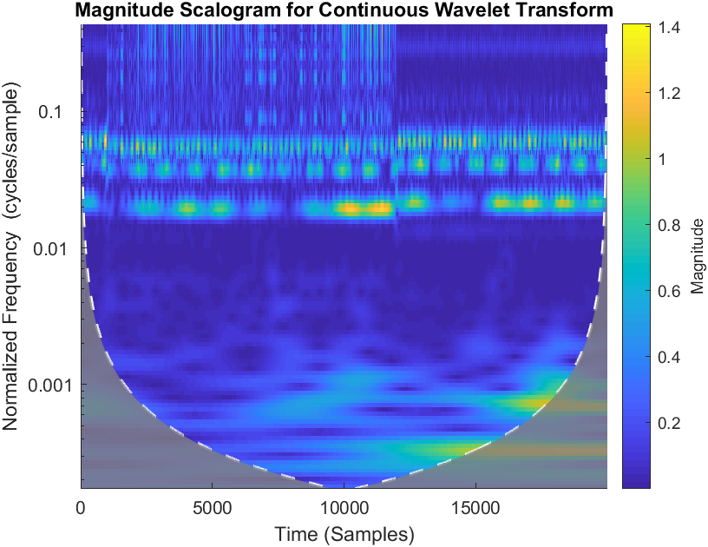
Wavelet Transformation:
Complete Frequency Information
In practice, a fast dwt is implemented as a tree of parallel HP and LP filters, defined by the mother wavelet. It is used predominantly in image processing.

Slide 14
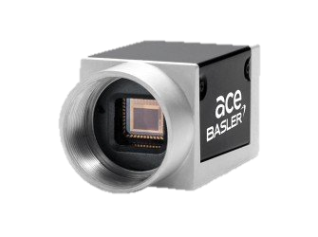

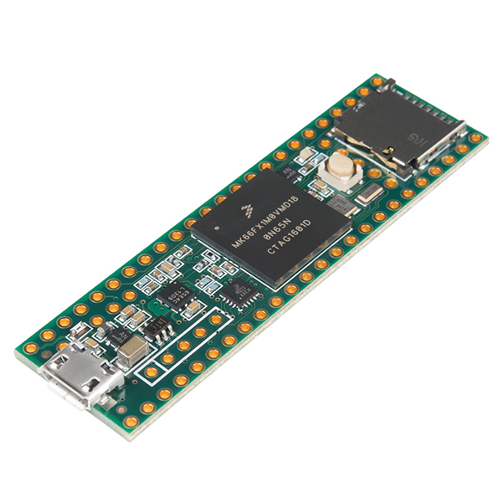
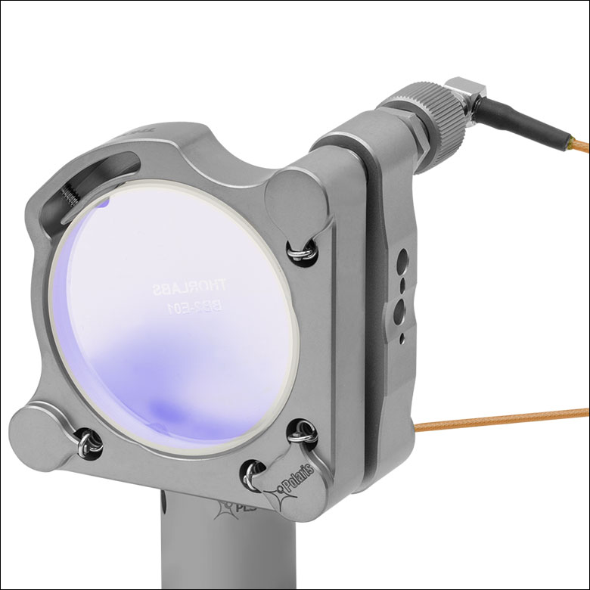
Implementation
Sensor Readout and Exposure
~370 us
Ethernet Transmission
~20 us
Centroid Calculation
~15 us
Filtering and predicting
~20 us

Slide 15
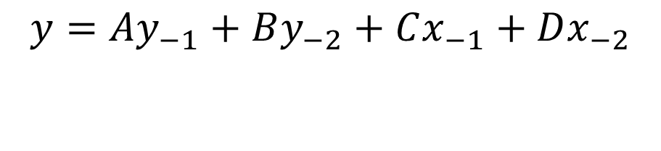
Centroid
DAC
$$y={Ay}_{−1}+By_{−2}+Cx_{−1}+Dx_{−2}$$

